Slide 1
Structure of forsterite at extreme conditions

Slide 2
Forsterite
Main component of the mantles of rocky planets
Its phase transitions provide insight into the formation, evolution, and habitability of rocky exoplanets
Plays a role in creating and shaping convection currents, influencing factors essential to habitable surface conditions
Notes:
-very important mineral to study in the field of planetary science
-Earth’s upper mantle and expected to be in rocky exoplanets
-abundant in space: meteorites, comets, accretion disks around young stars
-phase changes drive deep earthquake generation
-but mostly: second bullet
-also affects the cooling of the early magma ocean stage of planet formation, which contributes to geochemistry and thermal evolution of a planet
-mainly, plays a role in creating and shaping convection currents -> plate tectonics and magnetosphere -> surface conditions suitable to support life

Slide 3
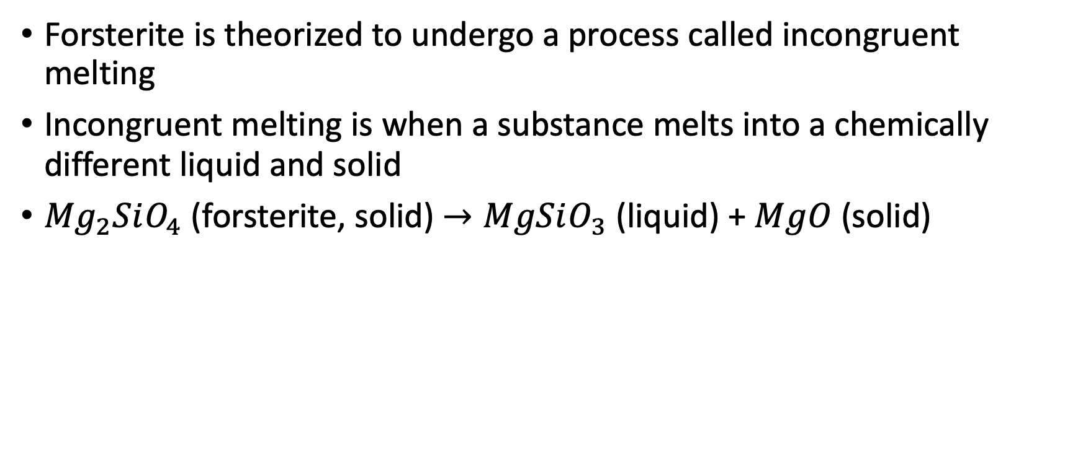
Incongruent melting
Forsterite is theorized to undergo a process called incongruent melting
Incongruent melting is when a substance melts into a chemically different liquid and solid
${Mg}_{2}SiO_{4}$ (forsterite, solid) $→MgSiO_{3}$ (liquid) + $MgO$ (solid)
Notes:
-this is just one of the possible ways forsterite will behave
-we are looking for crystal MgO in our experiment
-

Slide 4
Previous studies
Evidence supporting incongruent melting has been found in only two studies, but when it occurs is currently inconclusive
Sekine et al. (2016) – found slope changes in the hugoniot (pressure v density) attributed to incongruent melting at 271 to 285 GPa
Root (2018) – attempted to replicated Sekine et al. but did not get the same results
Newman (2018) – used X-ray diffraction and found evidence for incongruent melting at 150 to 195 GPa
Notes:
-Sekine measured the density for the hugoniot, and attributed slope changes to incongruent melting
-Root suggested that the pressure range found in Sekine is too high and suggested using X-ray diffraction
-X-ray diffraction is more accurate because it actually measures the crystal structure of the sample, which is more reliable than just a density measurement
-Newman’s dissertation used x-ray diffraction and found evidence at a lower pressure
-therefore this current experiement attempts to investigate this by using x-ray diffraction and conducting experiments at 150 and 260 GPa

Slide 5
The extreme pressures needed for this experiment are generated using laser produced shock waves
The sample consisted of a 150 𝜇𝑚 thick Kapton ablator, 130 𝜇𝑚 of powdered forsterite, and 100 𝜇𝑚 of window material (LiF)
Notes:
-the laser we use is the Omega-EP laser from the Laboratory for laser Energetics in Rochester
-window is used for VISAR shock wave velocity measurements (not applicable now)

